Slide 1
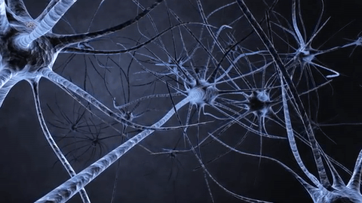
Neural Networks

Slide 2
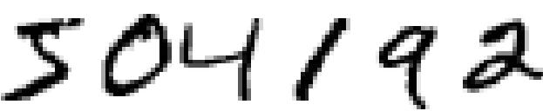
Could you recognize these characters?

Slide 3
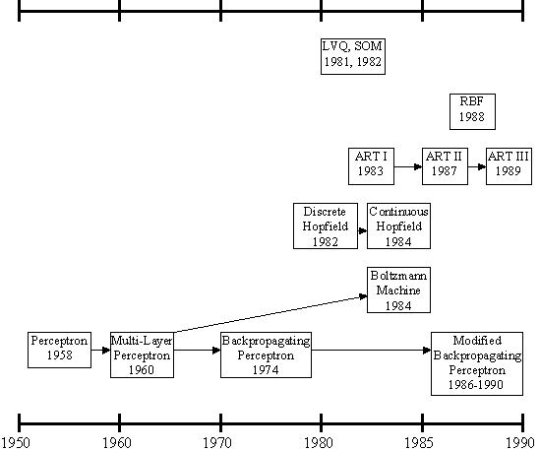
History

Slide 4
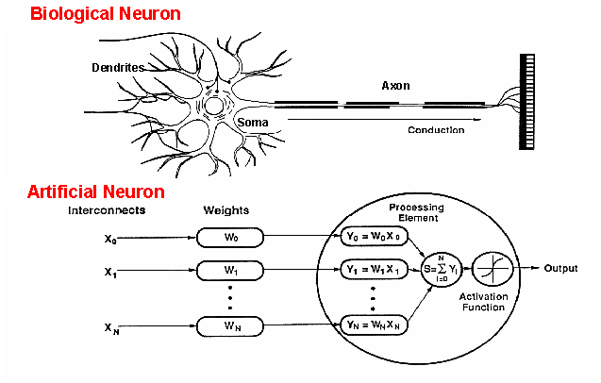
Parallel between biological neurons and perceptron

Slide 5
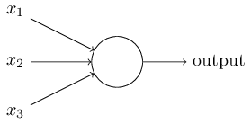
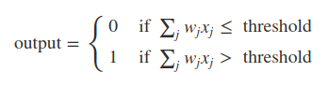
Perceptron

Slide 6
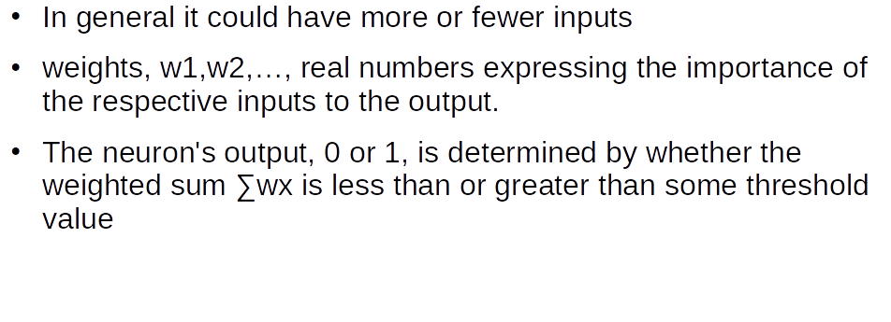
Perceptron

Slide 7
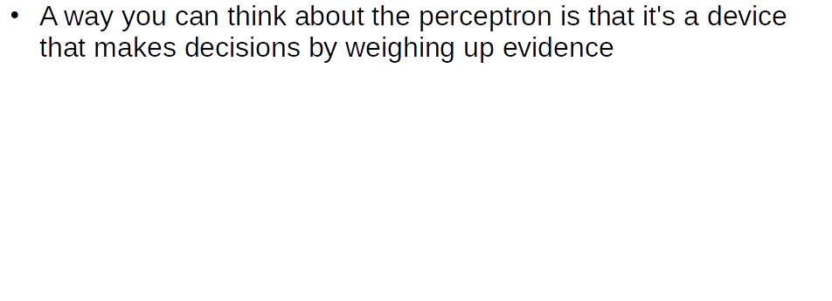
How to think about perceptrons

Slide 8
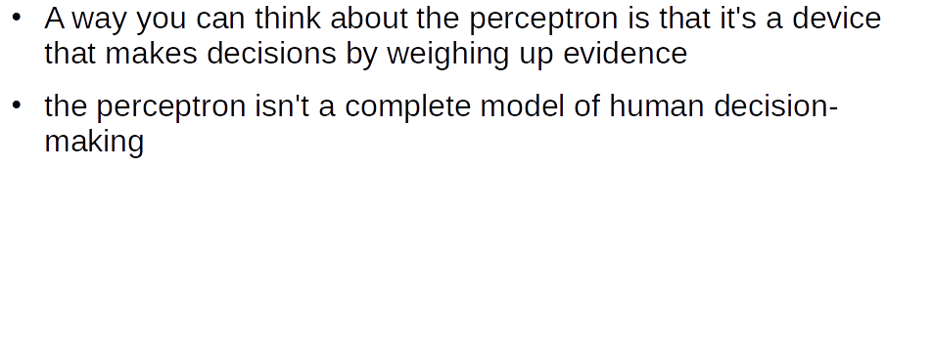
How to think about perceptrons

Slide 9
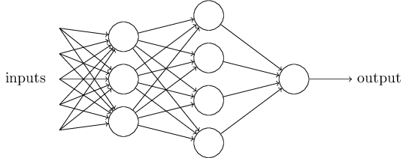
Neural Networks

Slide 10
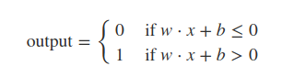
Neural Networks
b ≡−threshold
You can think of the bias as a measure of how easy it is to get the perceptron to output a 1
For a perceptron with a really big bias, it's extremely easy for the perceptron to output a 1
But if the bias is very negative, then it's difficult for the perceptron to output a 1

Slide 11
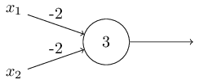
Perceptron as a universal gate
What is universal gate?
What is its truth table?

Slide 12
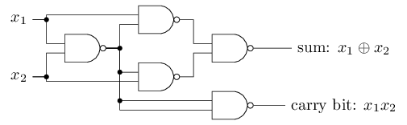
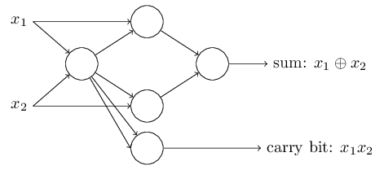
Universal Computational device

Slide 13
Universal Computational device
The universality of perceptron is reassuring and disappointing.
It is reassuring because it tells us that it is as good as any computing device.
But it's also disappointing, because it makes it seem as though perceptrons are merely a new type of NAND gate.

Slide 14
Universal Computational device
The Learning algorithms can figure out those weights and biases.
We don't have to stack nand gates like we seen in earlier example.
These weights and biases will be learn from external stimulus means data.

Slide 15
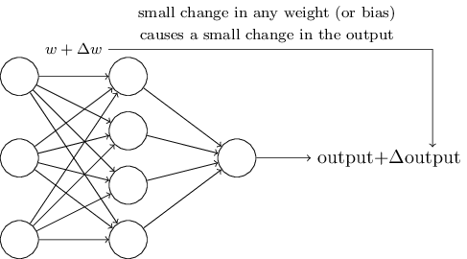
Learning Idea

Slide 16
Learning Idea
If our network misclassified ‘8’ as ‘9’
Then we can make change in
Weights such that it could classify 8 correctly
But this might completely change network output as small change in weights now we started miss classifying other digits
How to Solve this mystery?

Slide 17
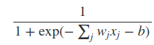
Sigmoid neuron
z≡w⋅x+b is a large positive number. Then e^{−z} ≈ 0 and so σ(z)≈1

Slide 18
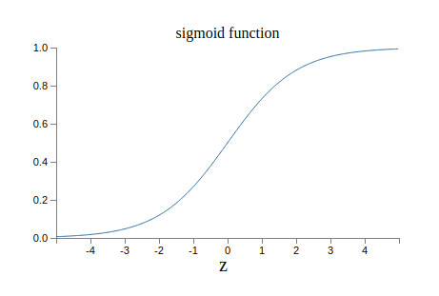
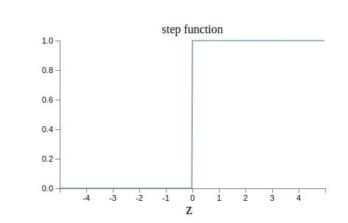
Sigmoid neuron

Slide 19
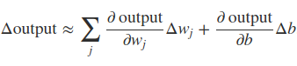
Learning algorithm
Due to smoothness of Sigmoid we can learn weights and biases to match desire predictions
sigmoid neurons have much of the same qualitative behaviour as perceptrons

Slide 20
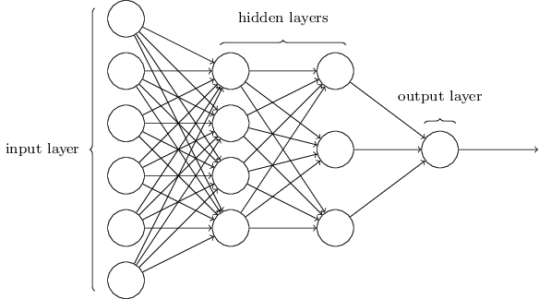
The architecture of neural network

Slide 21
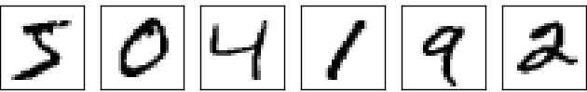
Network to classify handwritten digits

Slide 22
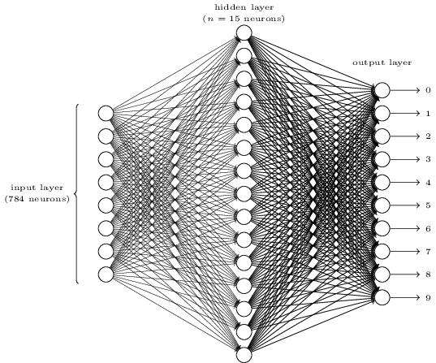
Network to classify handwritten digits

Slide 23
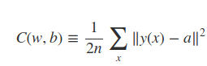
Learning algorithm

Slide 24
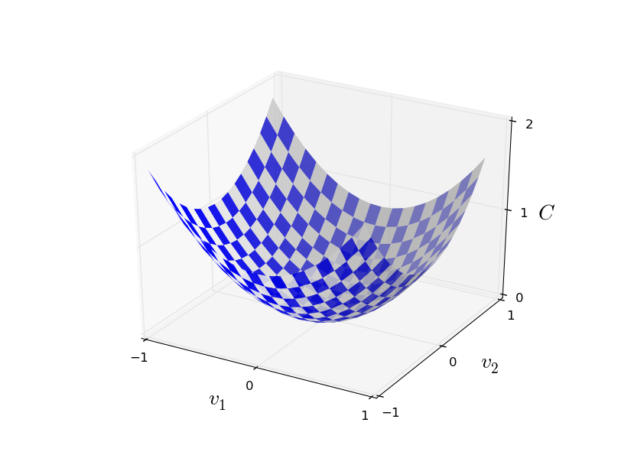
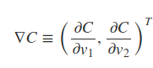
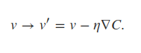
Gradient descent

Slide 25
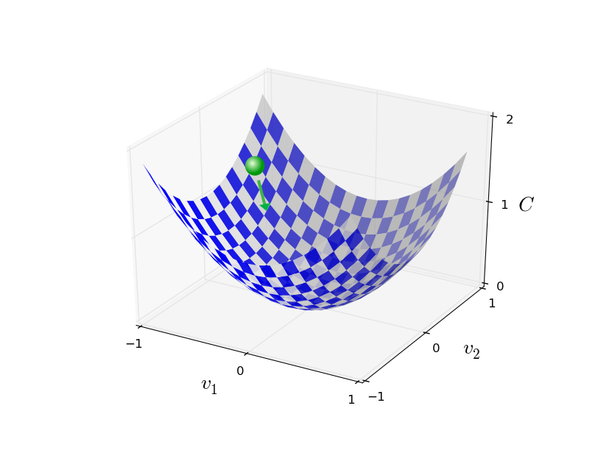
Gradient descent

Slide 26
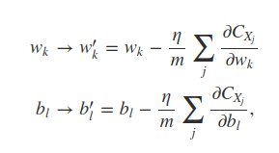
Gradient descent

Slide 27
Implementation
https://github.com/GaneshVShinde/backpropagation/blob/master/BackProp.py

Slide 28
Interesting neural network video (Must watch)
https://www.youtube.com/watch?v=aircAruvnKk

